Slide 1



Slide 2

Scan, Shop And Exchange
Supervised by:
Mr. Jamal Ahmad
Group Members:
Muhammad Faizan (SP18-BCS-009)
Hamza Zareen (SP18-BCS-024)
Department of Computer Science
COMSATS University Islamabad, Attock Campus

Slide 3
Outline
Introduction
Working flow
Problem statement
Objectives
Interface
Methodology
Modern tools
Benefits
References
_______________________________

Slide 4

Introduction
This project is aimed at developing an android application to make shopping easy. Using this Application, customers will easily find products they will be looking for.
It is not easy to define something you have seen in specific keywords. That’s the area where our application will be useful, because we will find the products user will looking for by taking the picture.
Sometimes people don’t want to buy product, they want to just barter their product with others. Our application will provide that functionality as well and also near to them by tracking their location.
We will also provide a recommendation list of items they may also like. That recommended list will be containing similar items they searched or looking for.
_______________________________

Slide 5
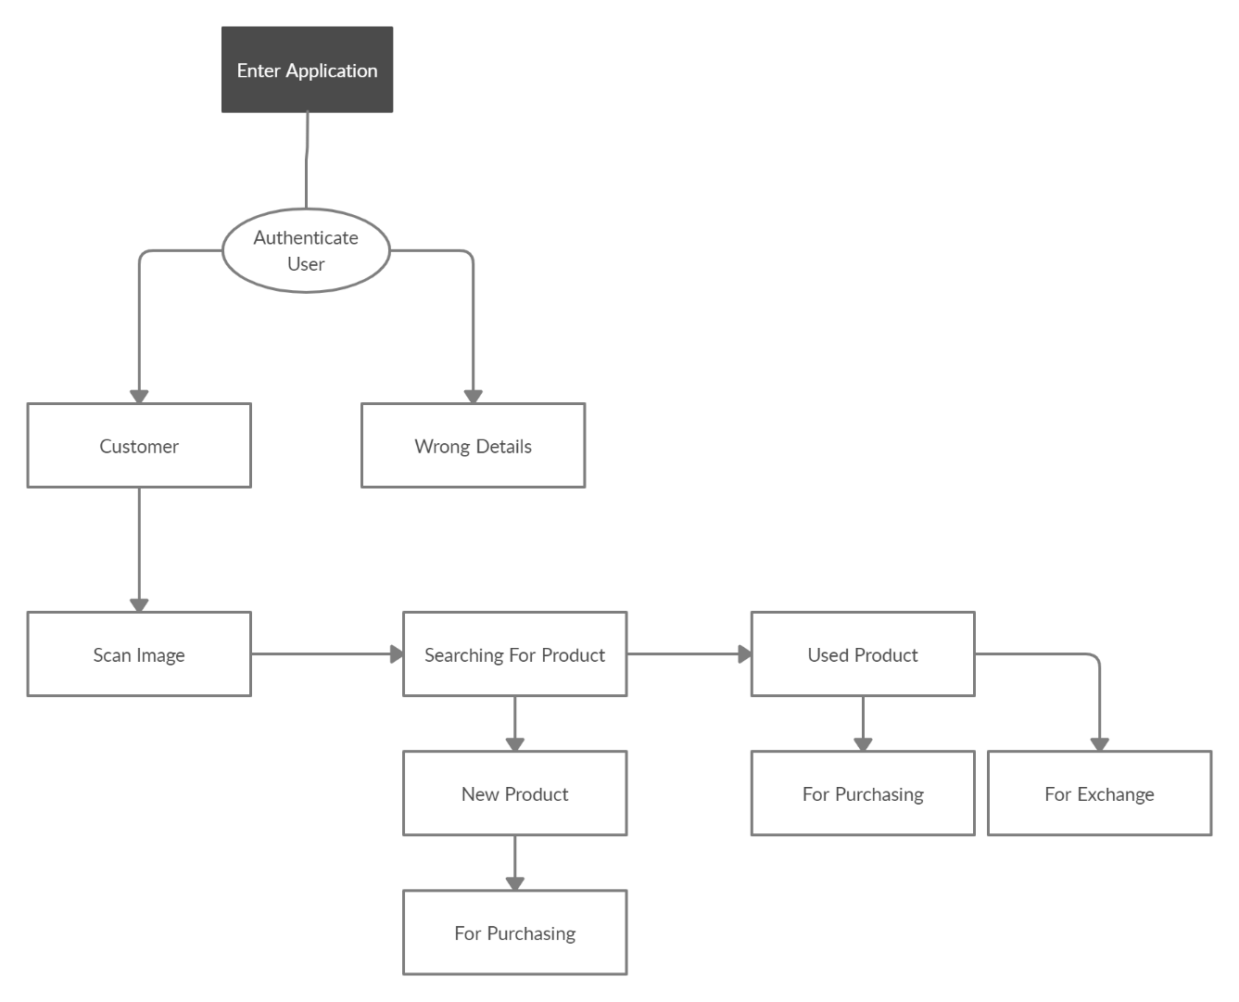
Working flow
_______________________________

Slide 6
Problem statement
The first problem is finding the correct product that you want to buy with less effort.
Also it is not easy to go to market for every product again and again that you want to buy.
Searching a product that you like and want that is not an easy task.
Finding perfect match for exchange.
_______________________________

Slide 7
Objectives
Our goal is to create a full flash android application that will bring a revolution in shopping industry.
The working of our project will be image processing by taking the picture with camera and finding the places from where people will buy or barter that thing.
The whole searching process will be done from the picture.
Our application will also provide similar items based on item-to-item and user-to-user collaborative filtering so that they can also try them as well.
The main objective of our project is to make a user friendly interface and easy to use.
_______________________________

Slide 8

Interface
_______________________________

Slide 9
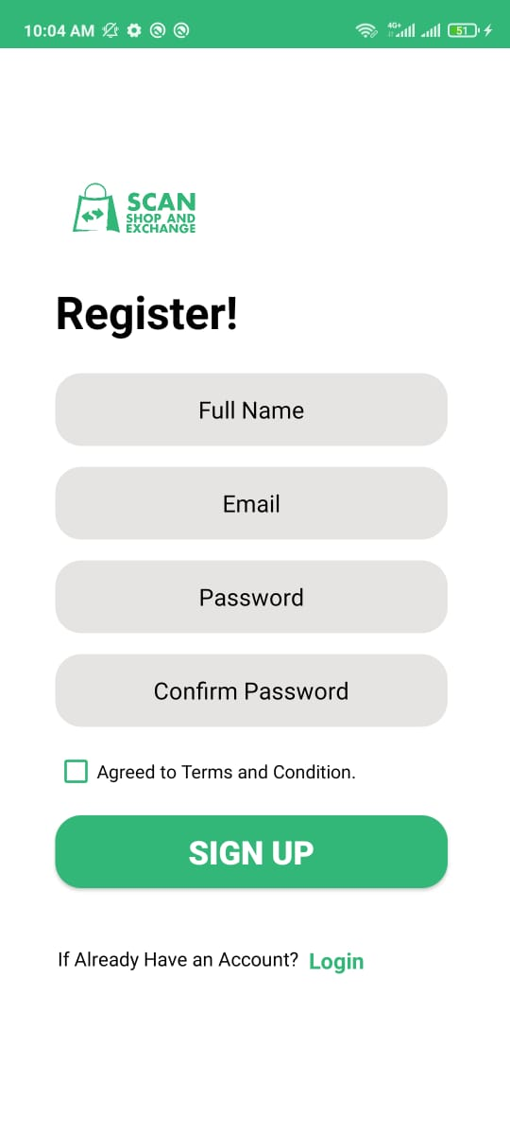
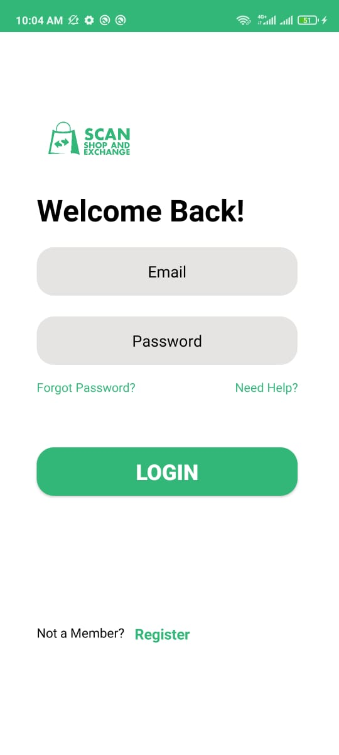
Register Activity
User have to register himself before start using this application.
Login
After registering himself user has to login into his account.
_______________________________

Slide 10
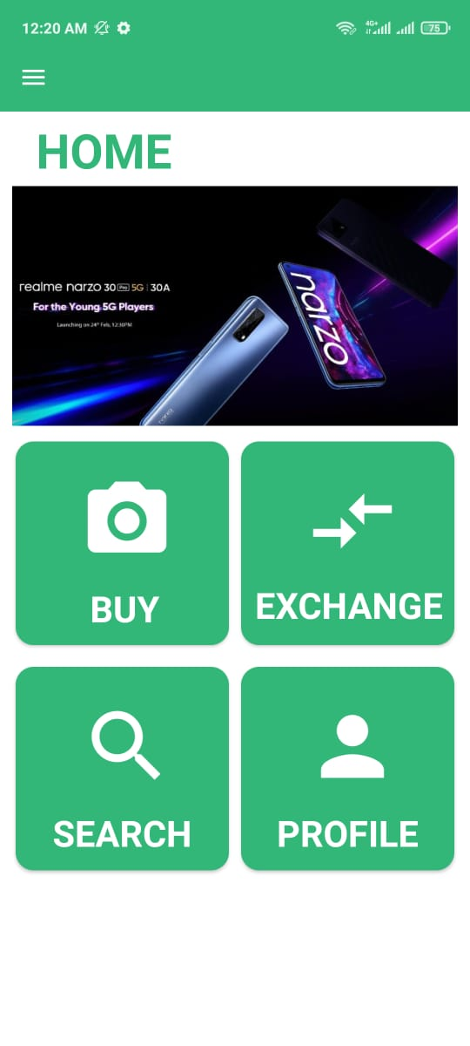
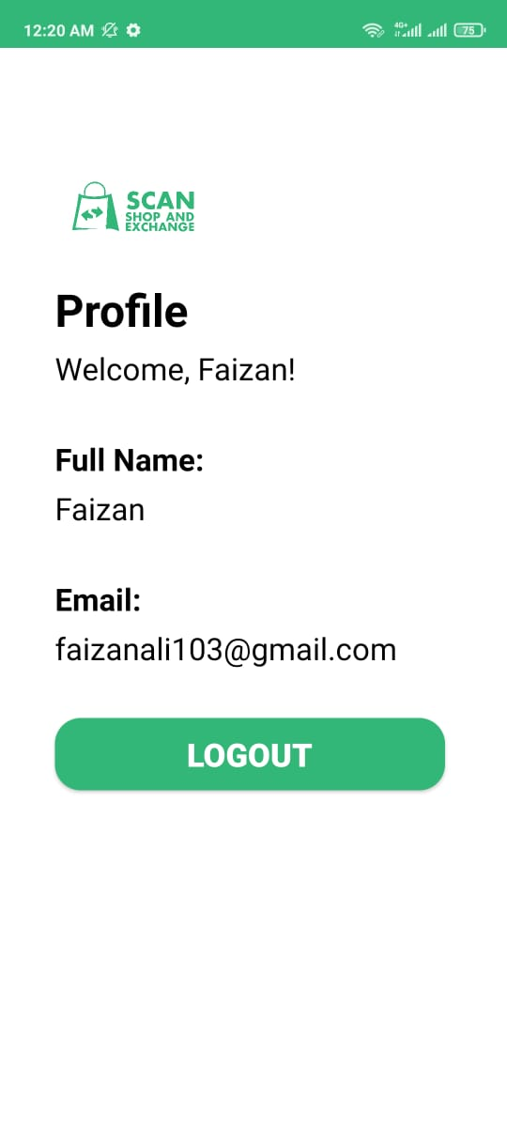
Dashboard
After login Homepage is shown to user.
Profile
User profile, which he can see after logging in.
_______________________________

Slide 11
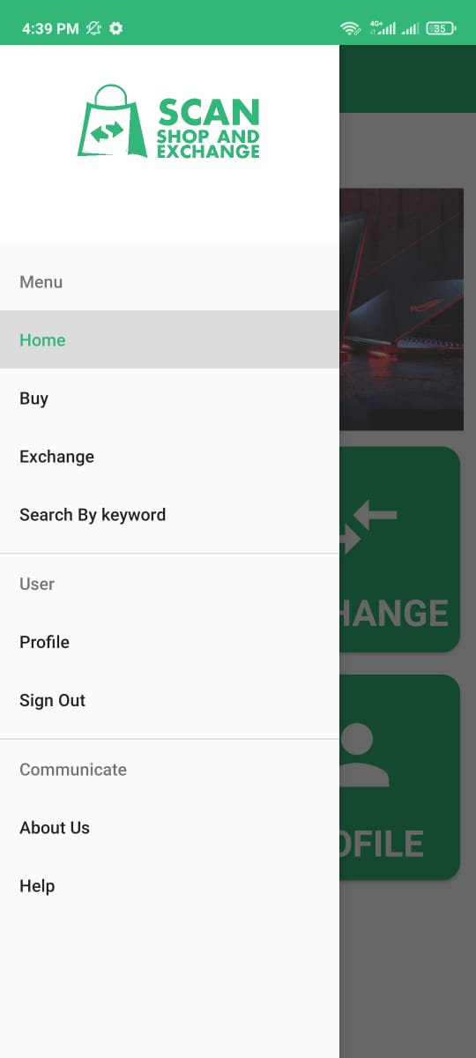
Drawer view
User can view Menu, Home, Buy, Exchange, Profile, sign out etc
_______________________________

Slide 12
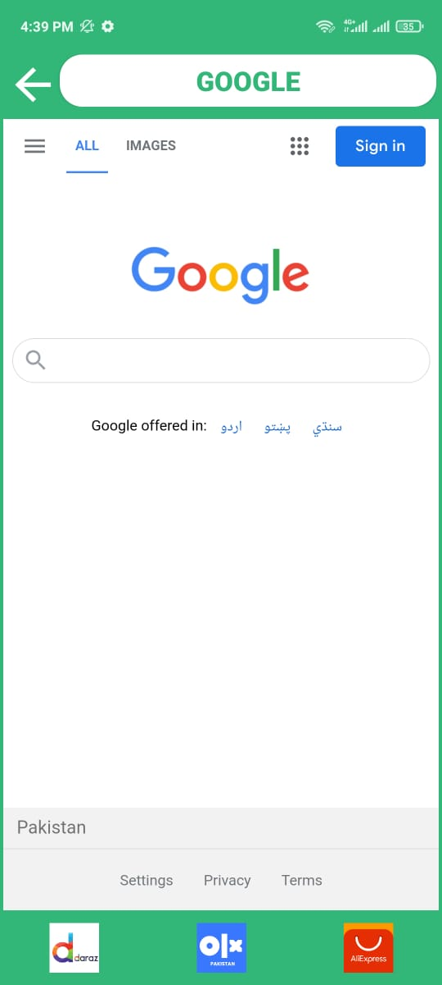
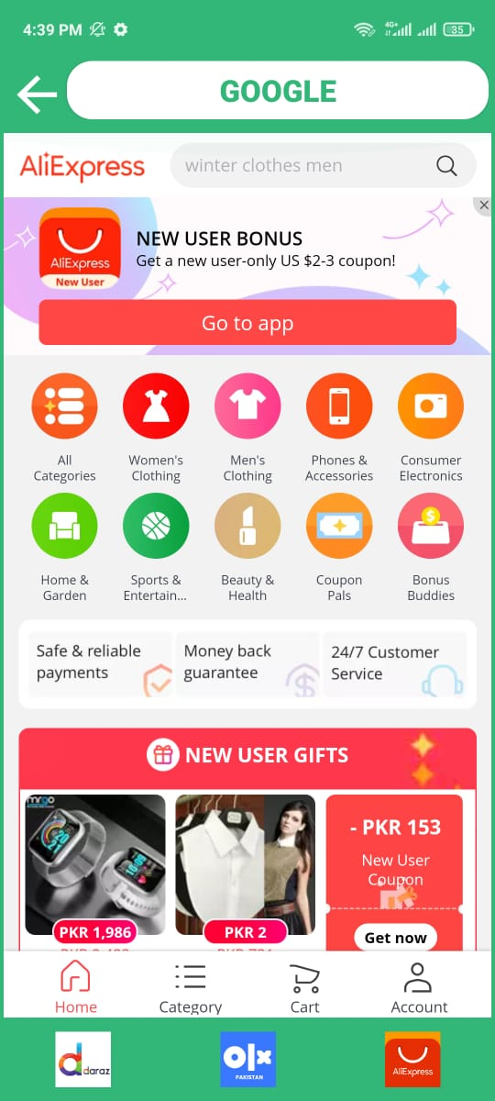
Google
Search by keyword in Google.
AliExpress
Search by keyword in Aliexpress
_______________________________

Slide 13
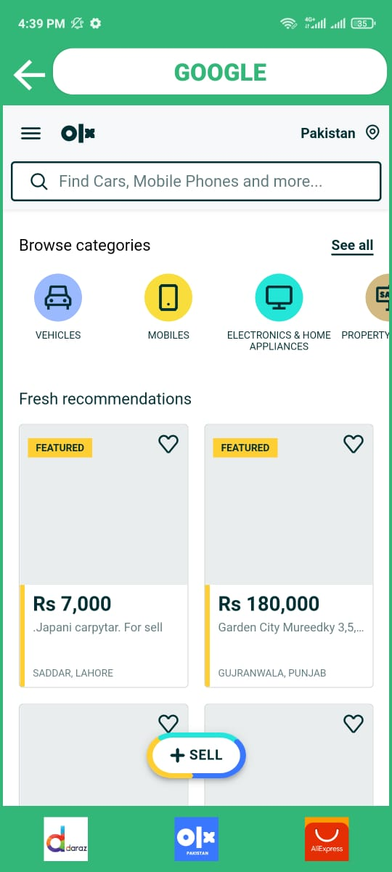
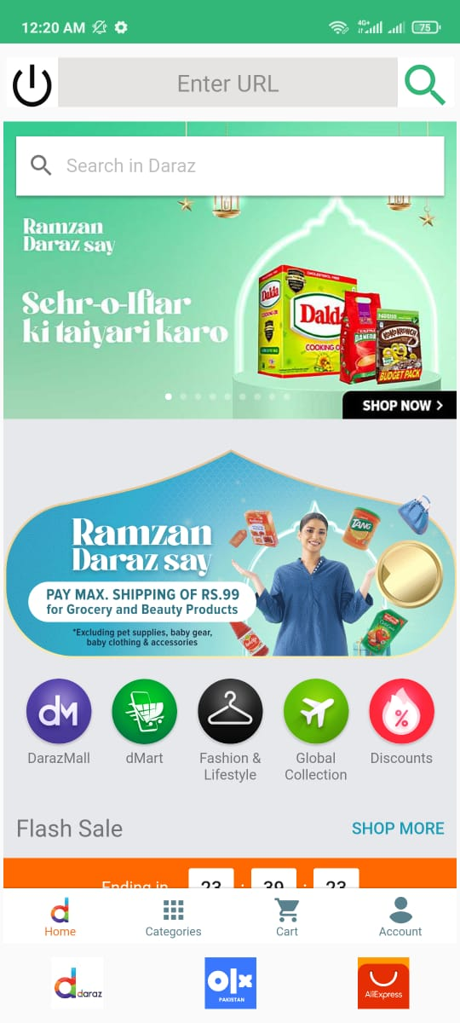
OLX
Search by keyword in OLX.
Daraz
Search by keyword in Daraz.
_______________________________

Slide 14
Development Requirements
Android Studio.
Java.
XML.
Python.
Figma.
Flask Framework.
Firebase.

Slide 15
Methodology
An Android Application will be developed, which will be used form easy shopping.
The customer will take picture of the product he/she wants. The Application will explore the internet and find the best possible match. Moreover it will give some recommendation related to your search.
Our application provides the facility of exchange.
_______________________________

Slide 16
Modern tools
Tools | Version | Rationale
Android studio | 3.3.2 | IDE
Adobe Photoshop | CC 2018 | Design Work
MS Word | 2019 | Documentation
MS Power Point | 2019 | Presentation
Figma | 2020 | Interface Design Tool
Technology | Version | Rationale
XML, Java, Python, Flask Framework, Firebase | 1.1, 6.0, 3.90, 1.1.2, 26.1.0 | Programming language
_______________________________

Slide 17
Benefits
Easy way of Shopping.
Time Saving.
Less Effort Needed.
There are the most popular applications used for shopping. But none of them provides the functionality of scan and shop as well as item exchange. These features make our application unique.
_______________________________

Slide 18
References
Developers are the site which helps you understand different aspects regarding your Android Application. Retrieved from: https://developer.android.com/reference
Tools will be used in for the development purpose are listed above. Retrieved from: https://firebase.google.com/
_______________________________

